Slide 1
Introduction to ML.NET 1.0
Name Goes Here
Notes:
@ankitasthana86 480
@cesardelatorre 2845
@clauren42 154

Slide 2
ML.NET Community Evidence

Slide 3


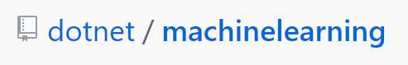
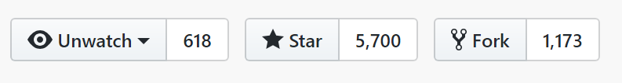
150K+
Downloads
ML.NET Open Source Momentum
1,427
Commits
1,528
Pull requests
106
Contributors

Slide 4








“ML.NET made it straightforward to leverage our existing .NET and C# skills and software assets to add machine learning capabilities into the application… deployed on Azure, the integration of machine learning models was easy and straightforward.”
Andy Gray, Executive Partner Evolution Software Design, Inc.
+ more ML.NET Customers
Notes:
Our customers have been embracing the productivity in our platform, languages and tools for 15+ years. We’re now gaining existing customers as well as new ones on our cloud-native, cross-platform, and device-native approaches with these new architectures. Here are just a few. There are many more (and their stories) on our website.

Slide 5
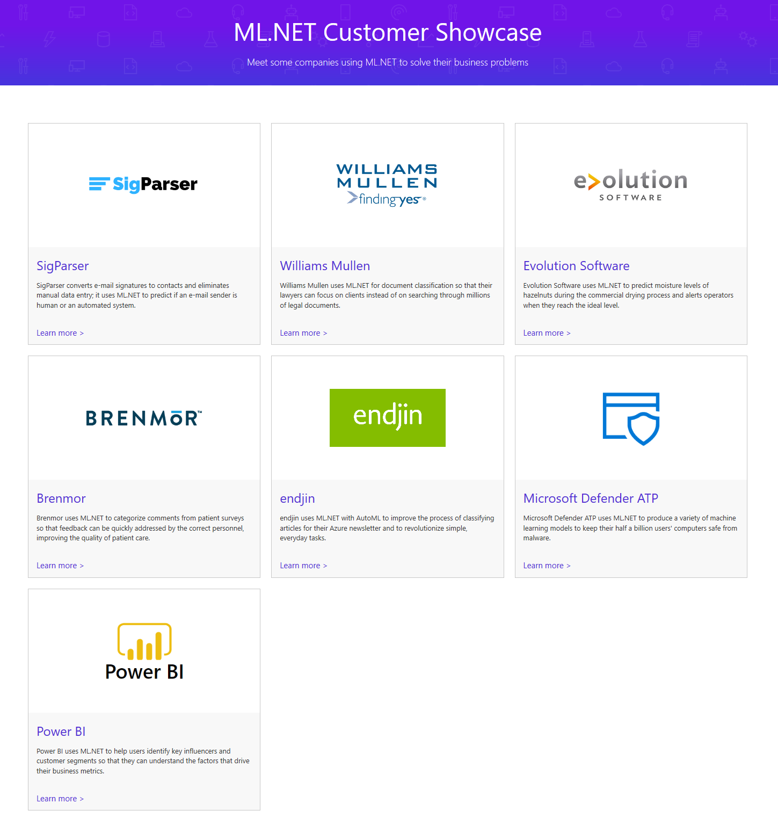
https://dotnet.microsoft.com/apps/machinelearning-ai/ml-dotnet/customers

Slide 6
ML.NET Features

Slide 7









Your platform for building anything
DESKTOP
WEB
CLOUD
MOBILE
GAMING
IoT
ML
.NET
Notes:
.NET is a great tech stack for building a wide variety of applications. There is ASP.NET for web development, Xamarin for mobile development and with ML.NET we are trying to make .NET great for Machine Learning.

Slide 8

Machine Learning “Programming the UnProgrammable”
{
{
Is this a face?
Price of Shirt?
f(x)
f(x)
“It has exquisite buttons … with long sleeves …works for casual as well as business settings”

Slide 9



Machine Learning “Programming the UnProgrammable”
{
Machine Learning creates a
Face
Face
f(x) Model
Not a face
Not a face
using this data
Notes:
A model is an intelligent function which can predict

Slide 10

ANNOUNCED @ Build2019
ML.NET 1.0 @Build 2019
ML.NET 1.0
Machine Learning framework for building custom ML Models Custom ML made easy Automated ML and Tools (Model Builder and CLI) Proven at scale Azure, Office, Windows
Extensible TensorFlow, ONNX and Infer.NET Cross-platform and open-source Runs everywhere

Slide 11
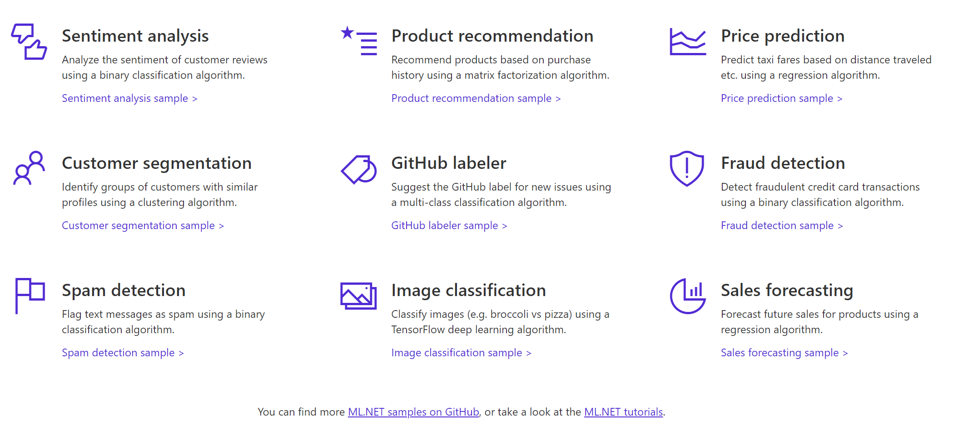

A few things you can do with ML.NET 1.0 …

Slide 12
Three key concepts (what might show up on future certification exams)

Slide 13
1. Data
Data
Example
Comment Text | Sentiment
Wow... Loved this place. | 1
Crust is not good. | 0
Not tasty and the texture was just nasty. | 0
The selection on the menu was great. | 1
Notes:
Dataset: https://github.com/dotnet/machinelearning/blob/master/test/data/wikipedia-detox-250-line-data.tsv

Slide 14
2. Transformers
Data
Data
Transformer
Data
Example
Text
Wow... Loved this place.
Crust is not good.
Not tasty and the texture was just nasty.
The selection on the menu was great.
Featurized Text
[0.76, 0.65, 0.44, …]
[0.98, 0.43, 0.54, …]
[0.35, 0.73, 0.46, …]
[0.39, 0, 0.75, …]
Text Featurizer
Notes:
Transformers take data, do some work on it, and return new transformed data.
One example of a transformer we will need in our example is a Text Featurizer, which takes the text in the issue text and converts it to numbers that our ML algorithms can understand.

Slide 15
3. Estimators
Data
Data
Transformer
Data
Data
Estimator
Transformer
Example
Comment | Sentiment
Wow... Loved this place. | 1
Crust is not good. | 0
Not tasty and the texture was just nasty. | 0
The selection on the menu was great. | 0
Estimator
Model (Transformer)
Notes:
An estimator learns from data to create a transformer. Now a model, which turns the input features into output predictions, is a transformer. So we can take estimators that take our example data and produce a model.

Slide 16
Sentiment Analysis
Is this a positive comment? Yes or no
Comment Text | Sentiment
Wow... Loved this place. | 1
Crust is not good. | 0
Not tasty and the texture was just nasty. | 0
The selection on the menu was great. | 1
Features (input)
Label (output)
Yelp review dataset
Notes:
Dataset: https://github.com/dotnet/machinelearning/blob/master/test/data/wikipedia-detox-250-line-data.tsv

Slide 17
Demo: Getting Started with ML.NET
Notes:
Installed Visual Studio Community 2019
Upgraded Power BI Desktop
Spam example – code
Chrome

Slide 18
.NET Advanced Features

Slide 19
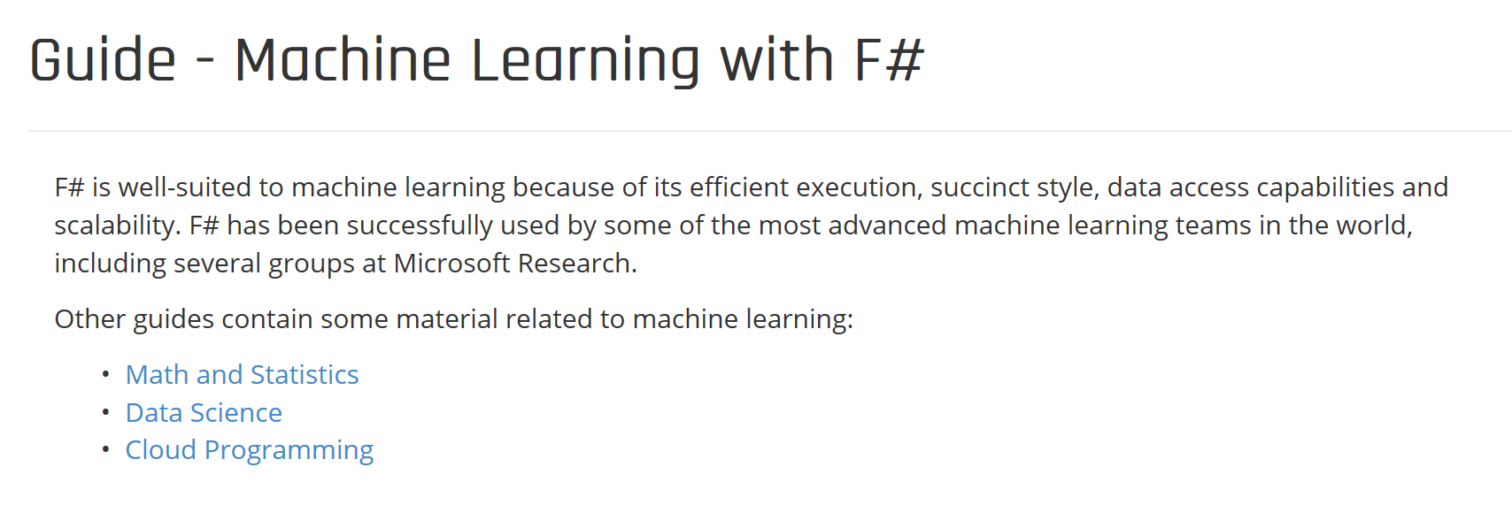
https://fsharp.org/guides/machine-learning/

Slide 20
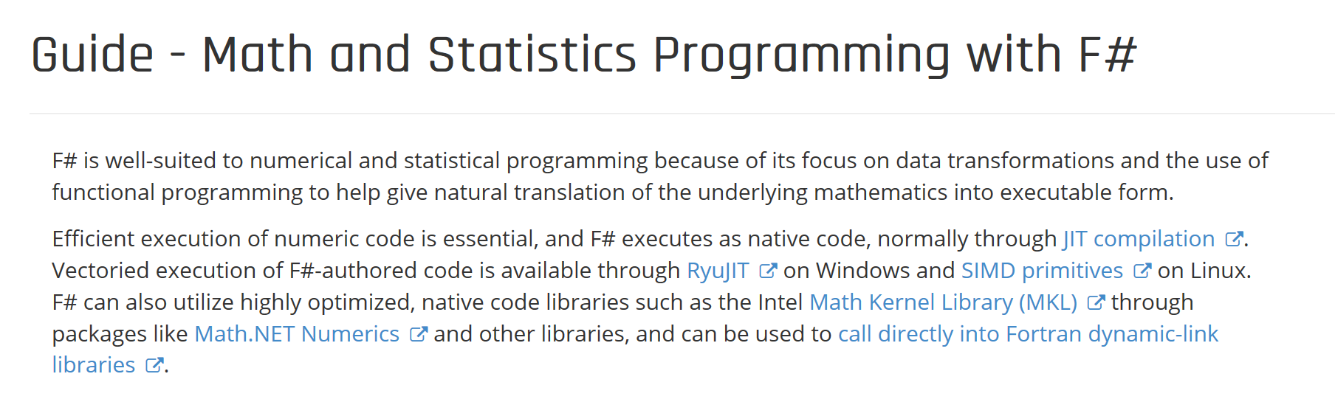
https://fsharp.org/guides/math-and-statistics/

Slide 21
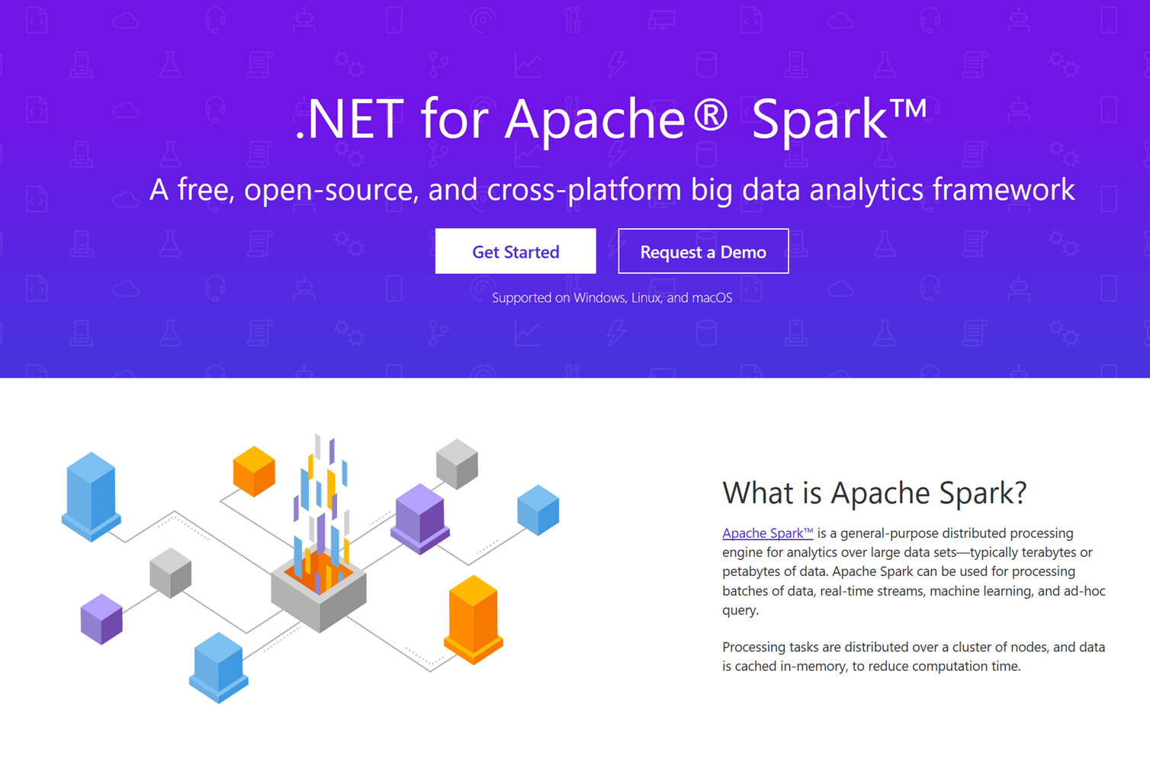
https://dotnet.microsoft.com/apps/data/spark

Slide 22
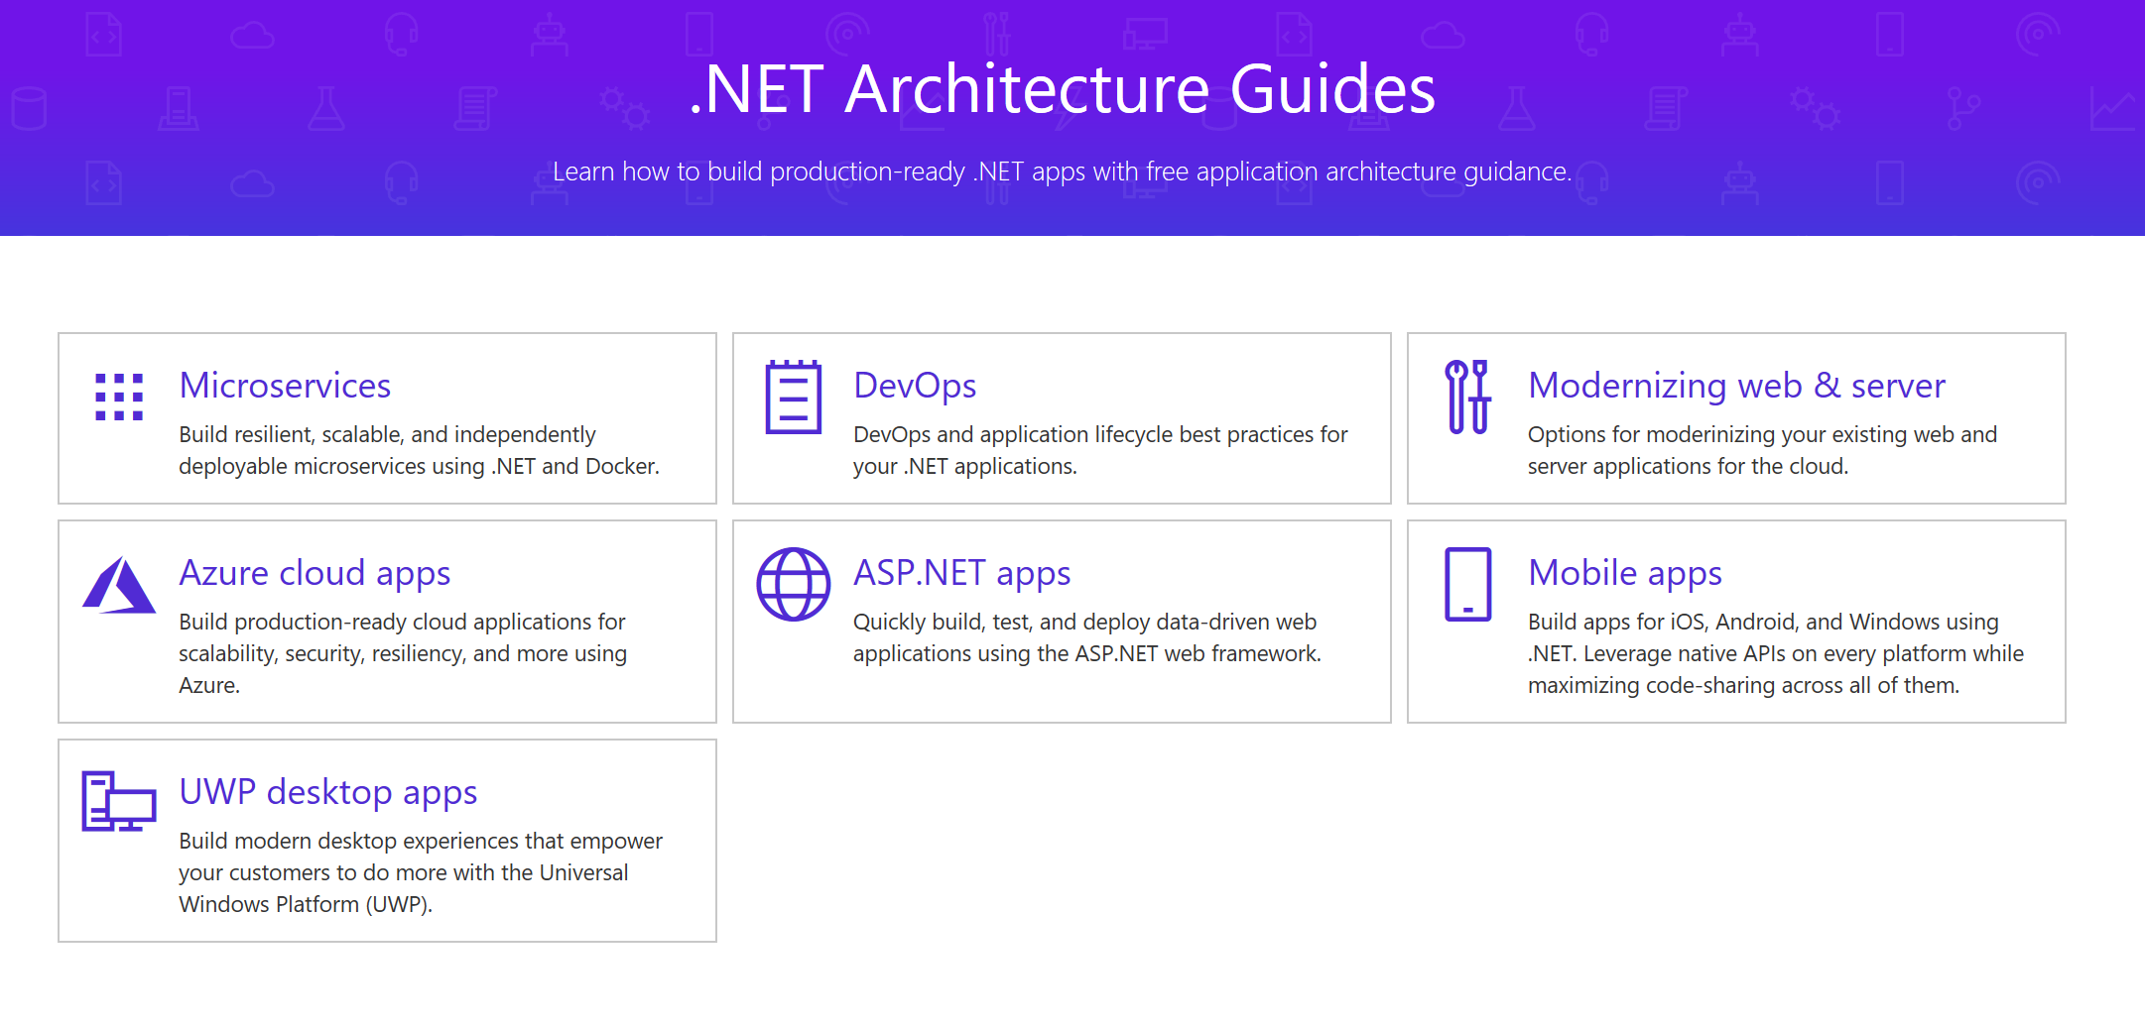
https://dotnet.microsoft.com/learn/dotnet/architecture-guides

Slide 23
ML.NET Action

Slide 24
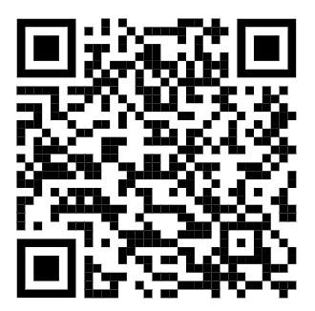
Action Step: Try ML.NET Today!
Get started at http://dot.net/ml
Try the samples at http://aka.ms/ai-mlnetsamples
Read the docs at http://aka.ms/mlnetdocs
Next Session
Request features or contribute at http://aka.ms/mlnet

